Slide 1
Al-Farabi Kazakh National University
Higher School of Medicine
HORMONES AND THEIR ACTIONS

Slide 2
Part 1

Slide 3
LEARNING OUTCOMES
As a result of the lesson you will be able to:
identify the chemical classes to which various hormones belong;
describe how hormones are synthesized and transported to their target organs;
describe how hormones stimulate their target cells;
explain how target cells regulate their sensitivity to circulating hormones;
describe how hormones affect each other when two or more of them stimulate the same target cells; and
discuss how hormones are removed from circulation after they have performed their roles.
Al-Farabi Kazakh National University
Higher School of Medicine

Slide 4
Hormone Chemistry
Most hormones fall into three chemical classes: steroids, monoamines, and peptides.
Al-Farabi Kazakh National University
Higher School of Medicine

Slide 5
Steroid hormones
are derived from cholesterol;
they include sex steroids produced by the testes and ovaries (such as estrogens, progesterone, and testosterone) and corticosteroids produced by the adrenal gland (such as cortisol, aldosterone, and DHEA).
Calcitriol, the calcium-regulating hormone, is not a steroid but is derived from one and has the same hydrophobic character and mode of action as the steroids, so it is commonly grouped with them.
Al-Farabi Kazakh National University
Higher School of Medicine

Slide 6
Monoamines (biogenic amines)
include dopamine, epinephrine, norepinephrine, melatonin, and thyroid hormone. The first three of these are also called catecholamines.
are made from amino acids and retain an amino group, from which this hormone class gets its name.
Al-Farabi Kazakh National University
Higher School of Medicine

Slide 7
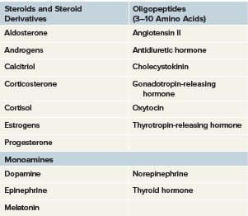
Steroids and monoamines
Al-Farabi Kazakh National University
Higher School of Medicine

Slide 8
Peptide hormones
are chains of 3 to 200 or more amino acids.
The two posterior pituitary hormones, oxytocin and antidiuretic hormone, are very similar oligopeptides of just nine amino acids. Probably the best-known large peptide (protein) hormone is insulin. Except for dopamine, the releasing and inhibiting hormones produced by the hypothalamus are polypeptides. Most hormones of the anterior pituitary are polypeptides or glycoproteins—polypeptides conjugated with short carbohydrate chains. Glycoprotein hormones usually have an identical alpha chain of 92 amino acids and a variable beta chain that distinguishes them from each other.
Al-Farabi Kazakh National University
Higher School of Medicine

Slide 9
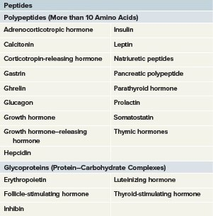
Peptides
Al-Farabi Kazakh National University
Higher School of Medicine

Slide 10
Hormone Synthesis
All hormones are made from either cholesterol or amino acids, with carbohydrate added in the case of glycoproteins.
Al-Farabi Kazakh National University
Higher School of Medicine

Slide 11
Synthesis of Steroids
Steroid hormones are synthesized from cholesterol and differ mainly in the functional groups attached to the four-ringed steroid backbone.
While estrogen and progesterone are typically thought of as “female” hormones and testosterone as a “male” hormone, these sex steroids are interrelated in their synthesis and have roles in both sexes.
Al-Farabi Kazakh National University
Higher School of Medicine

Slide 12
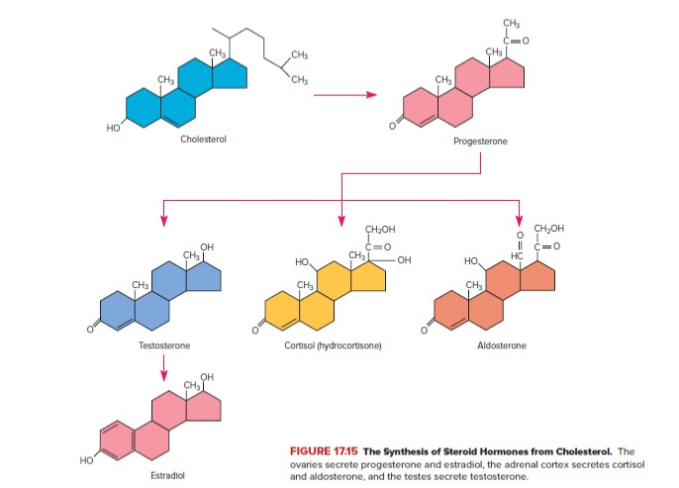
Synthesis of Steroids
Al-Farabi Kazakh National University
Higher School of Medicine

Slide 13
Synthesis of Peptides
Peptide hormones are synthesized the same way as any other protein. The gene for the hormone is transcribed to form a molecule of mRNA, and ribosomes translate the mRNA and assemble amino acids in the right order to make the peptide. After the basic amino acid sequence is assembled, the rough endoplasmic reticulum and Golgi complex may further modify the peptide to form the mature hormone.
Al-Farabi Kazakh National University
Higher School of Medicine

Slide 14
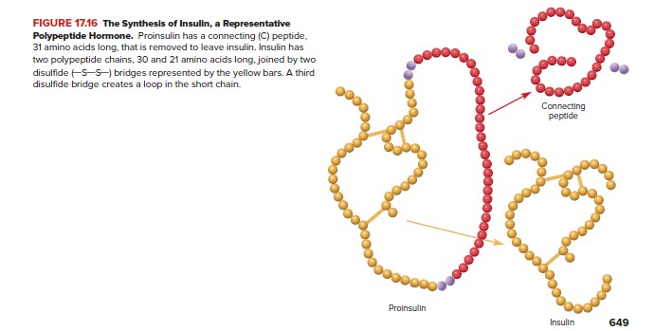
Synthesis of Peptides
Al-Farabi Kazakh National University
Higher School of Medicine

Slide 15
Synthesis of Monoamines
Melatonin is synthesized from the amino acid tryptophan and all the other monoamines from the amino acid tyrosine. Thyroid hormone (TH) is quite unusual in that it is made of two tyrosines, and is the only process in the human body that uses iodine; a lack of dietary iodine causes a thyroid disorder called goiter.
Al-Farabi Kazakh National University
Higher School of Medicine

Slide 16
Synthesis of Thyroid hormone
1. Cells of the thyroid follicule begin the process by absorbing iodide (I–) ions from the blood of nearby capillaries. At the apical surface of the cells, facing the lumen of the follicle, they oxidize I– to a reactive form of iodine represented by I* in the figure.
Al-Farabi Kazakh National University
Higher School of Medicine

Slide 17
Synthesis of Thyroid hormone
2. In the meantime, the follicle cells also synthesize a large protein called thyroglobulin (Tg). Each Tg has 123 tyrosines among its amino acids, but only 4 to 8 of them are used to make TH. The cells release thyroglobulin by exocytosis from their apical surfaces into the lumen.
Al-Farabi Kazakh National University
Higher School of Medicine

Slide 18
Synthesis of Thyroid hormone
3. An enzyme at the cell surface adds iodine to some of the tyrosines. Some tyrosines receive one iodine and become monoiodotyrosine (MIT) (MON-oh-eye-OH-do-TY-roseen); some receive two and become diiodotyrosine (DIT). Where the Tg folds back on itself and two tyrosines meet, or where one tyrosine meets another on an adjacent Tg, the tyrosines link to each other through their side groups.
If an MIT links up with a DIT, they form a complex with three iodines, destined to become the T3 form of thyroid hormone; if two DITs unite, they form the forerunner of the T4 form, with four iodines. One tyrosine then breaks away from its Tg, but for the time being, the hormone remains anchored to Tg through its other tyrosine. Tg is stored in the follicles until the thyroid gland receives a signal to release it.
Al-Farabi Kazakh National University
Higher School of Medicine

Slide 19
Synthesis of Thyroid hormone
4. When the follicle cells receive thyroid-stimulating hormone (TSH) from the anterior pituitary, they absorb droplets of Tg by pinocytosis. Within the cells, a lysosome contributes an enzyme that hydrolyzes the Tg chain, liberating thyroid hormone (TH).
Al-Farabi Kazakh National University
Higher School of Medicine

Slide 20
Synthesis of Thyroid hormone
5. TH is released from the basal side of the follicle cells into nearby blood capillaries. In the blood, it binds to various transport proteins that carry it to its target cells. The released hormone is about 10% T3 and 90% T4.
Al-Farabi Kazakh National University
Higher School of Medicine

Slide 21
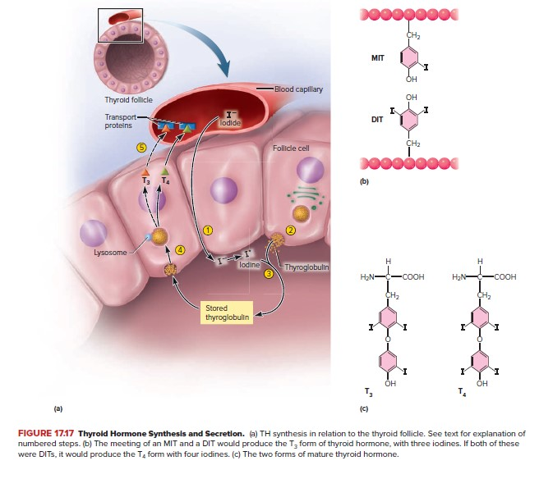
Al-Farabi Kazakh National University
Higher School of Medicine

Slide 22
Hormone Secretion
Hormones are secreted in some cases on a daily (circadian) rhythm, in other cases on a monthly rhythm (in a woman’s ovarian cycle), or under the influence of stimuli that signify a need for them. These stimuli are of three kinds.
Al-Farabi Kazakh National University
Higher School of Medicine

Slide 23
1. Neural stimuli
Nerve fibers supply some endocrine glands and elicit the release of their hormones. For example,
- the sympathetic nervous system stimulates the adrenal medulla to secrete epinephrine and norepinephrine in situations of stress.
- in childbirth, nerve signals originate from stretch receptors in the uterus, travel up the spinal cord and brainstem to the hypothalamus, and stimulate the release of.
Al-Farabi Kazakh National University
Higher School of Medicine

Slide 24
2. Hormonal stimuli
Hormones from the hypothalamus regulate secretion by the anterior pituitary gland, and pituitary hormones stimulate other endocrine glands to release thyroid hormone, sex hormones, and cortisol.
Al-Farabi Kazakh National University
Higher School of Medicine

Slide 25
3. Humoral stimuli
This refers to blood-borne stimuli. For example,
- rising blood glucose concentration stimulates the release of insulin;
- low blood osmolarity stimulates the secretion of aldosterone;
- low blood calcium level stimulates the secretion of parathyroid hormone.
Al-Farabi Kazakh National University
Higher School of Medicine

Slide 26
Secretion of hormones
Peptide hormones such as growth hormone and oxytocin, and catecholamines such as epinephrine and dopamine, are stored in secretory vesicles of the endocrine cell until needed and released by exocytosis when the cell receives a stimulus to do so.
Al-Farabi Kazakh National University
Higher School of Medicine

Slide 27
Secretion of hormones
Steroid hormones such as estrogen and cortisol, however, are not stored in vesicles or released by exocytosis. They do not accumulate in the endocrine cell, but are released as fast as they are synthesized by diffusion through the cell surface. But this does not mean they are secreted at a constant rate, hour by hour and day by day. Stimuli such as FSH and ACTH can increase the synthesis and release of a steroid hormone by several-fold within hours.
Al-Farabi Kazakh National University
Higher School of Medicine

Slide 28
Thyroid hormone (TH) also diffuses freely through plasma membranes, but unlike steroids, it does accumulate in the gland awaiting a stimulus for secretion. It is not stored in the endocrine cells, but in the extracellular spaces enclosed by the thyroid follicles. Until the stimulus (TSH) to secrete it arrives, it is bound to the protein thyroglobulin and cannot escape. The thyroid gland is thus able to store a large quantity of hormone, enough to meet the body’s need for months even if TH synthesis ceases.
Al-Farabi Kazakh National University
Higher School of Medicine

Slide 29
Hormone Transport
Most of the monoamines and peptides are hydrophilic, so mixing with the blood plasma is no problem for them. Steroids and thyroid hormone, however, are hydrophobic. To travel in the watery bloodstream, they must bind to hydrophilic transport proteins—albumins and globulins synthesized by the liver. A hormone attached to a transport protein is called a bound hormone, and one that is not attached is an unbound (free) hormone. Only the unbound hormone can leave a blood capillary and get to a target cell.
Al-Farabi Kazakh National University
Higher School of Medicine

Slide 30
Hormone Transport
Transport proteins not only carry the hydrophobic hormones, but also prolong their half-lives. They protect hormones from being broken down by enzymes in the blood plasma and liver and from being filtered out of the blood by the kidneys. Free hormone may be broken down or removed from the blood in a few minutes, whereas bound hormone may circulate for hours to weeks.
Al-Farabi Kazakh National University
Higher School of Medicine

Slide 31
Hormone Transport
Thyroid hormone binds to three transport proteins in the blood plasma: albumin; an albumin-like protein called thyretin; and most of all, an alpha globulin named thyroxine-binding globulin (TBG). More than 99% of circulating TH is protein-bound. Bound TH serves as a long-lasting blood reservoir, so even if the thyroid is surgically removed (as for cancer), no signs of TH deficiency appear for about 2 weeks.
Al-Farabi Kazakh National University
Higher School of Medicine

Slide 32
Hormone Transport
Steroid hormones bind to globulins such as transcortin, the transport protein for cortisol. Aldosterone is unusual. It has no specific transport protein but binds weakly to albumin and others. However, 85% of it remains unbound, and correspondingly, it has a half-life of only 20 minutes.
Al-Farabi Kazakh National University
Higher School of Medicine

Slide 33
Hormone Receptors and Mode of Action
Hormones stimulate only those cells that have receptors for them— their target cells. The receptors are proteins or glycoproteins located on the plasma membrane, in the cytoplasm, or in the nucleus. They act like switches to turn certain metabolic pathways on or off when the hormones bind to them. A target cell usually has a few thousand receptors for a given hormone. Receptor defects lie at the heart of several endocrine diseases.
Al-Farabi Kazakh National University
Higher School of Medicine

Slide 34
Hormone Transport
Receptor–hormone interactions are similar to the enzyme– substrate interactions described under “Enzymes and Metabolism” in section 2.4. Unlike enzymes, receptors do not chemically change their ligands, but they do exhibit enzymelike specificity and saturation. Specificity means that the receptor for one hormone will not bind other hormones. Saturation is the condition in which all the receptor molecules are occupied by hormone molecules. Adding more hormone cannot produce any greater effect.
Al-Farabi Kazakh National University
Higher School of Medicine

Slide 35
Hormone Transport
Steroid hormones bind to globulins such as transcortin, the transport protein for cortisol. Aldosterone is unusual. It has no specific transport protein but binds weakly to albumin and others. However, 85% of it remains unbound, and correspondingly, it has a half-life of only 20 minutes.
Al-Farabi Kazakh National University
Higher School of Medicine

